Slide 1
Lattice to PRISM Pipeline

Slide 2
Lattice Overview
For each point in the lattice
For a given N (number of controller iterations)
Compute the next point on the lattice based on the number of LEC classifications from 0 to N
So the lattice can determine if a sequence of LEC detections and misdetections is guaranteed safe
Conservatism
The resulting lattice is a 2-d array of points where each point has a set of transitions to other points on the lattice
The transitions are based on the number of LEC detections and misdetections

Slide 3
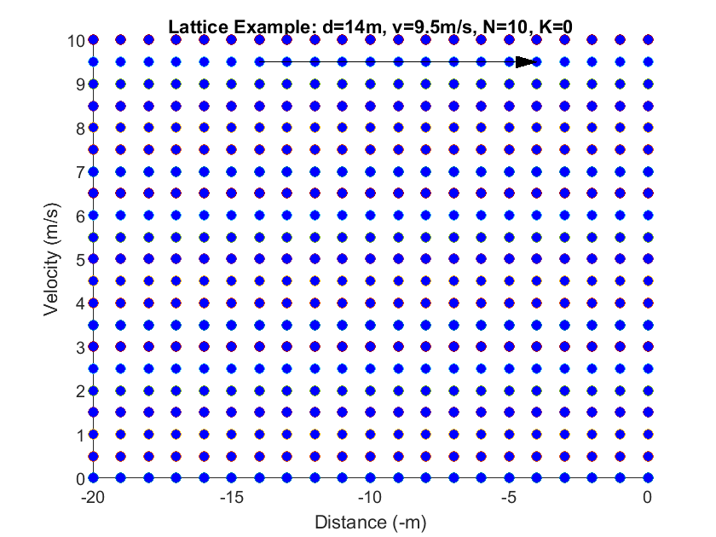
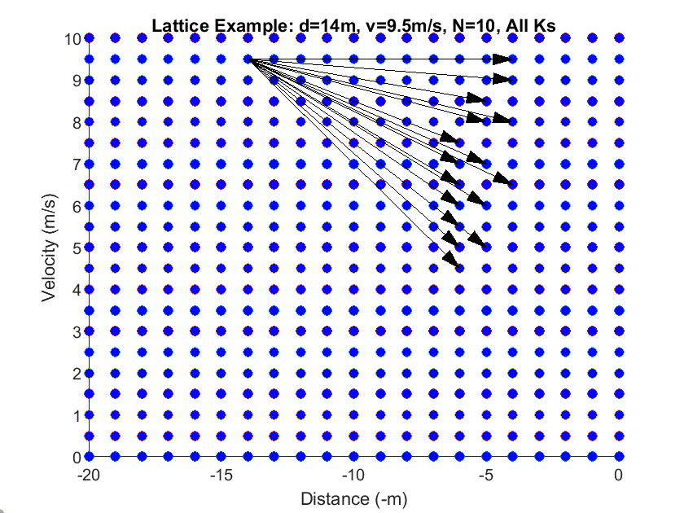
Constructing Lattice Transitions

Slide 4

Visuals

Slide 5
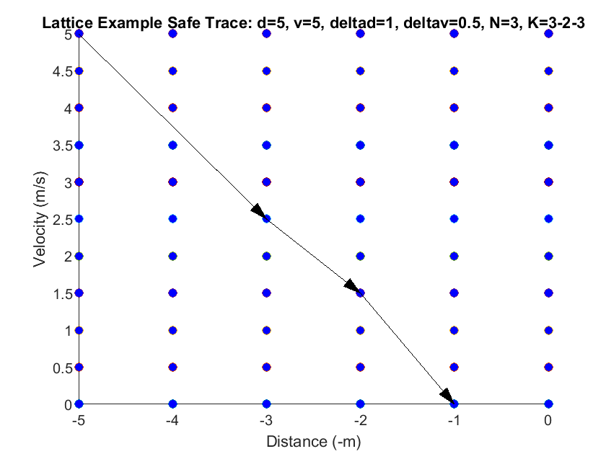
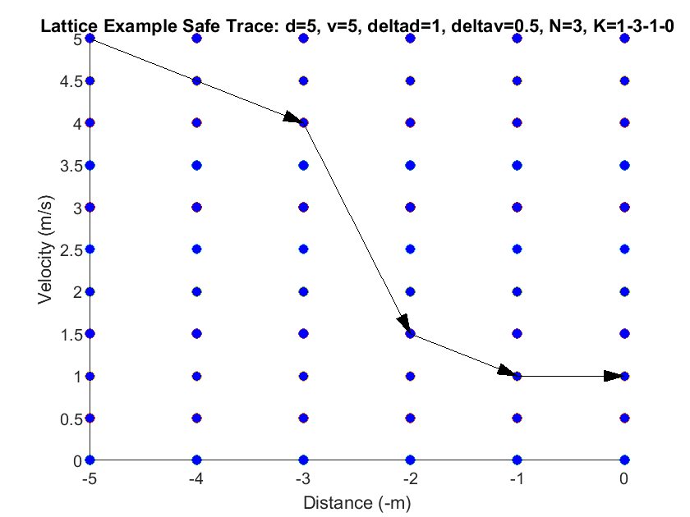
Safe/Unsafe Traces

Slide 6
Lattice and LEC Model
The lattice is composed with a perception LEC model
The LEC model produces sequences of detections/misdetections to run through the lattice
This results in a Markov Decision Process (MDP)
MDP: markov chain with non-deterministic transitions
There are tools for analyzing MDPs
Eg PRISM

Slide 7
Lattice Workflow
The lattice is generated and populated in MATLAB
Transitions for different Ns are added at this time
This results in a non-deterministic state machine
MATLAB converts the lattice into a PRISM model
Gets composed with a probabilistic model of the LEC
Becomes a Markov Decision Process (MDP)
PRISM analyzes the resulting MDP to compute the probability bounds for various properties of the system
Lower bound probability of crashing
Upper bound probability of stopping without crashing

Slide 8
I/O Composition
Car and AEBS Controller
Lattice
LEC Model
Perception
Discretization and abstraction
Ex. Fixed true positive rate
Markov Decision Process
The LEC model outputs serve as the inputs to the lattice
PRISM
Lower bound on true probability of crashing

Slide 9
Lattice as Program Abstraction
The lattice is an abstraction of the real car and controller dynamics
Concrete Program: car and controller
States: 2 positive, real-valued states: position and velocity
Semantics: Differential equations describing the car’s motion, the code for computing the controller’s braking power and the LEC outputs
Abstract Program: Lattice
States: 2 positive, integer valued states: position and velocity (forms a 2-D grid of cells)
Semantics: Transitions from one lattice point to another based on sequences of LEC outputs
Abstraction function: Rounding the position down and the velocity up
Concretization function: Producing the range of positions and velocities for a given lattice cell

Slide 10
Simple Example
A car is moving down the road towards a static obstacle
The car is equipped with the AEBS braking system and a learning-based image classifier
What is the probability that the car will not hit the obstacle?

Slide 11
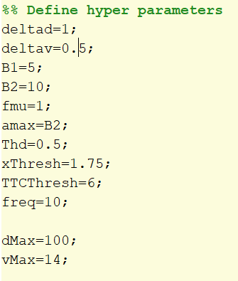
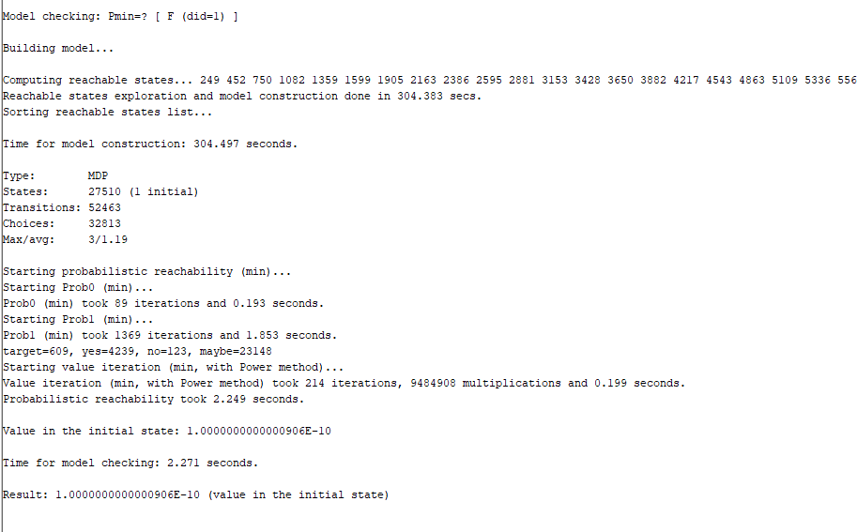
Initial Conditions and Result
Notes:
The K out of N contract gave 0.999998 probability of safety
- N = 75, K = 61
This approach gives 0.9999999999
The analysis took just over 5 mins

Slide 12
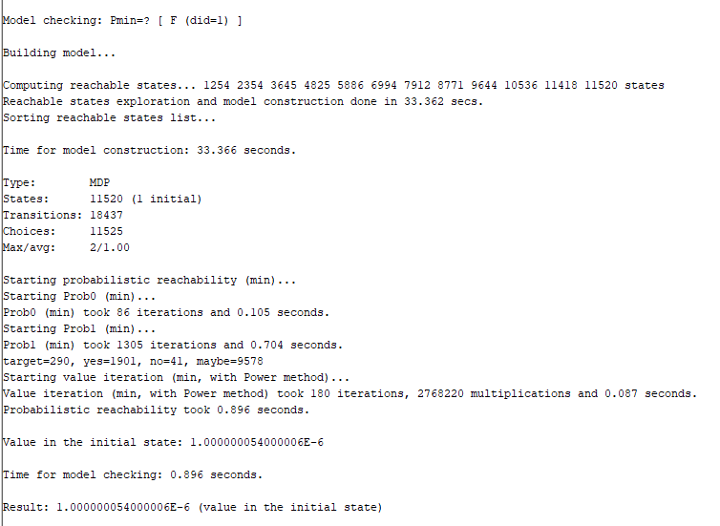
Only N=3
Notes:
P(safe) = 0.999999
Took about 33 seconds

Slide 13
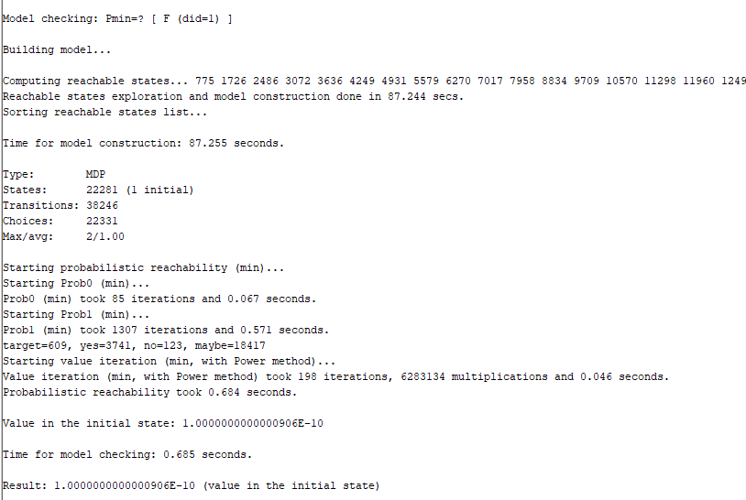
Only N=5
Notes:
P(safe)=0.9999999999
Took 90 second

Slide 14
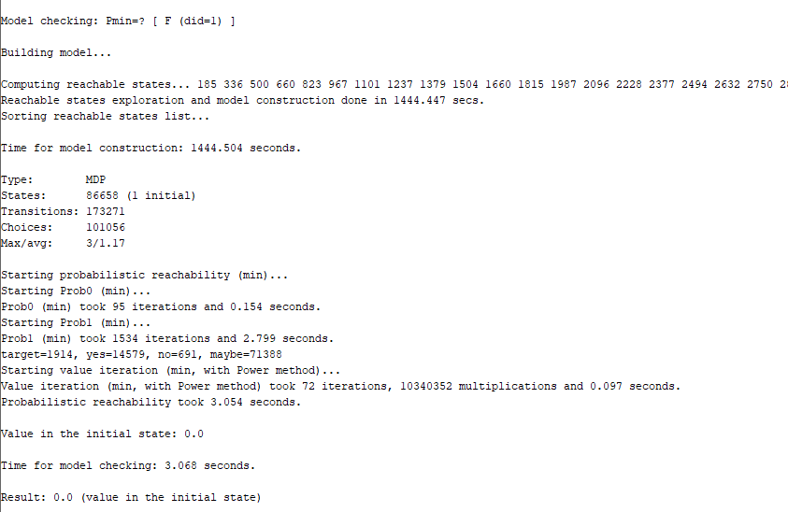
Extra N
Notes:
Also has N=10
P(safe)=1
Took around 24 mins

Slide 15
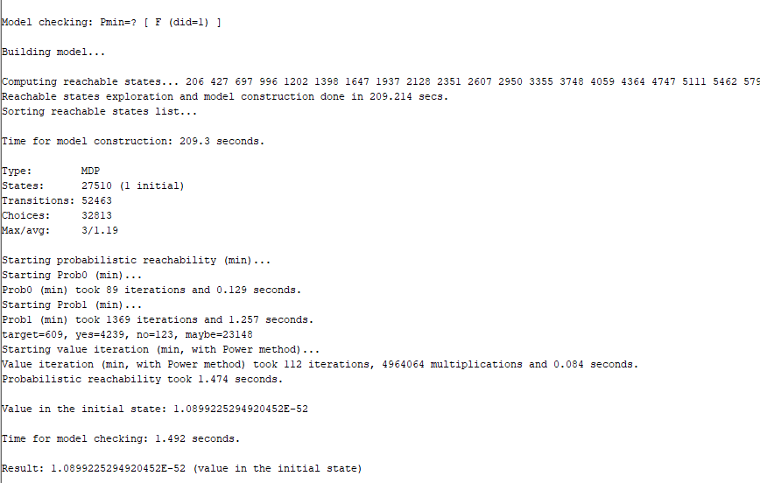
Better LEC
Notes:
P(safe)=0.9999 to 52 places
Took 210 seconds

Slide 16
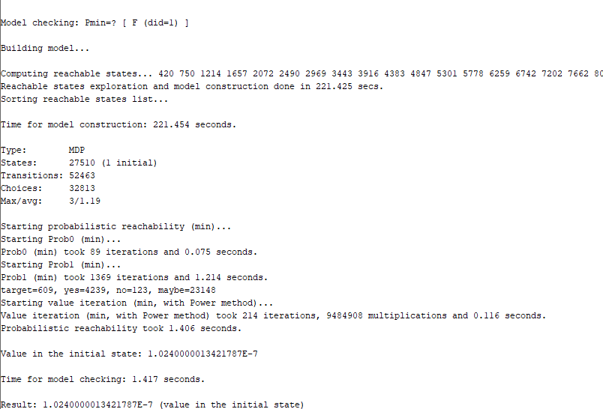
Worse LEC
Notes:
P(safe)=0.9999999
Took 225 seconds

Slide 17
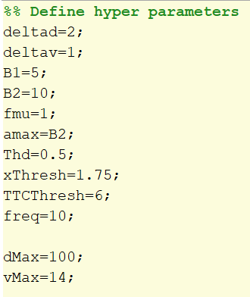
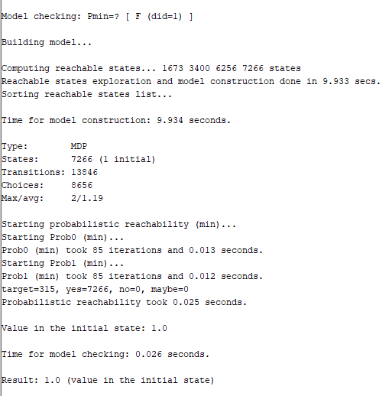
Larger Discretization
Notes:
Gives P(safe)=0
Took 10 seconds

Slide 18
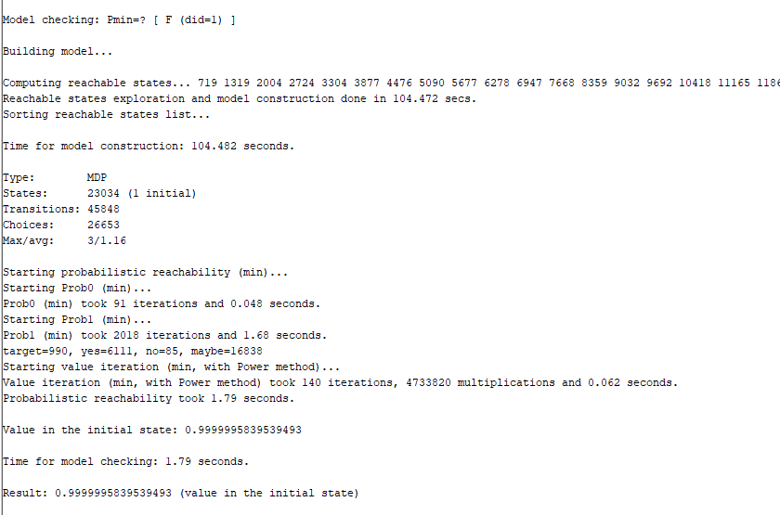
Larger Discretization, Larger N
Notes:
P(safe)=0.00000001
Took 105 seconds

Slide 19
Takeaways
Using larger N values leads to better safety estimates
Intuition: The lattice runs the system dynamics for N trials, then rounds to the nearest point
So larger N values lead to less (worst case) rounding
Using coarser discretization leads to worse safety estimates
Intuition: Coarse discretization leads to more rounding
Can lead to moderate amounts of braking being ignored
Notes:
Note that these are estimates of safety, NOT the actual safety

Slide 20
Issue: Nondeterminism
The mdp has 2 sources of non-determinism
Choosing which N value to use
The lattice contains the transitions for multiple N values and PRISM gets to pick the ‘best’ ones when doing the analysis
Choosing how to order the detections/misdetections when building the analysis
Recall: the ordering of the LEC detections affects which lattice point the model transitions to
There isn’t a full ordering over the lattice, so we cannot know of the points is worse, so we allow all the transitions non-deterministically and let PRISM pick the ‘worst’
So one source of non-determinism is ‘best case’ and the other is ‘worst case’
One workaround: only use one N for analyzing the lattice

